Slide 1
WW43’25 SWAV TOOL
Shockwave
What-if
Analysis
validation

Slide 2
Ask Informational
Schedule Milestones
Description | Plan | Status
Project Kick-off Initial conversation with development | 10/27/25 | Done
List Data-enablement requirements from data Source. Understand VIRJE connection feasibility for BOM lists Understand ORACLE connection feasibility for current inventory quantity Enable connection with manual workbooks having below information Item Master list (Shockwave part #, supplier, lead time, unit cost, UOM, standard freight cost etc. Manual Demand: | 11/7/25
Define SDA key figures and cell value (Quantitate vs Qualitative) Current supplier (Stephen Gould) unit cost is $1.38 New supplier (Nelipak) unit cost is $0.90
PO switch from Expense to Inventory PO Expense PO cancellation and recreation on inventory PO | 10/30/25
PROJECT: Shockwave What-if Analysis Validation |  | Updated: 10/27/25
Goal | Create in-house tool to assess Ad-hoc build plan changes for materials feasibility and financial impact.
Scope | Inventory items (Direct & Indirect) materials managed thru Oracle impacting below areas: Purchasing: Materials availability and new requirements Logistics: Freight impact cost and pull-in needs Financial: Current inventory cost & new scenarios impact Warehouse: Awareness on potential WH occupancy requirements.
Expected Benefit | AOP financial accuracy improvement Flexible scenarios simulation Real time measurable business impact. | Team: -Procurement (Monse, Kim & Erick) -Logistics (Silvia) -Warehouse (Jonathan) -Tojii (Alvaro)
Leader | Erick Duarte
Sponsor | TBD
Financials | N/A
X
Project Health
Schedule | Budget | Resources | Scope
Project Objectives |  | Objective Status Update
1 | Understand J&J toolbox environment and data conexion.
Completed Actions / Recent Successes
Planned Actions
Create list for ALL PN attributes (Unit Cost, Freig
Risks and Issues
Item # | R or I | Impact (L/M/H) & Description | Mitigation(s)
1 | N/A | N/A | N/A

Slide 3
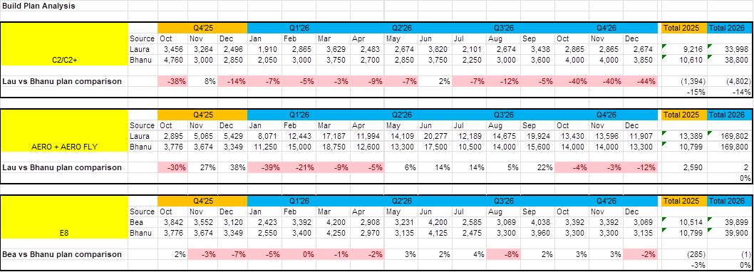

Business case
1
Clarify the Problem
Currently, Shockwave doesn’t have a tool for What-If Analysis to measure/validate new or (ad-hoc) intended build plan changes and their impact

Slide 4
Business case
2
Proposed Solution
Create a tool that allows buyer to perform simulations on demand changes at FG level, this will trigger BOM explosion to validate intended changes feasibility.
Demand Changes at FG Level [DELTAS].
What-if IF we want to...
FG67914-2512 | Increase demand by 3K on WW49 but decrease 2K in WW51 & WW52 too
FG67914-3012 | Increase demand by 1,5K on WW49 but decrease 1K in WW51 & 0.8K in WW52
FG67914-3512 | Increase demand by 1K on WW49 but decrease 0,5K in WW51 & WW52 too
FG67914-4012 | Increase demand by 2K on WW49, increase 1K in WW51 and decrease 5K on WW52
SDA (Supply Daily Analysis) Details – Checking Constrained parts.
Where I will see the impact...
Constrain on WW53 onwards to meet build plan requirements.
Buyer response to this scenarios is “Unsupported” but clan create more scenarios and recommend new “linearity” to planning to minimize the impact while propose a recovery plan.
In case of material constraints, we can simulate changes on the build plan mix to validate feasibility.

Slide 5
Business case
3
Nice to have
Create a tool that allows buyer to simulate scenarios driven by demand changes based on buyer preferences and market requirements.

